Slide 1


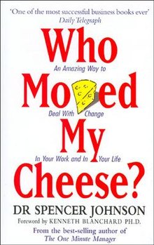
12 June 2019- Library : Book sharing sessions on
Making It On My Own: Ten Inspiring Stories Of Your Entrepreneur-Next-Door by Prashant Karhade
shared by Dr.Snehalata Aghashe
SNEAK PEEK
Making It On My Own: Ten Inspiring Stories Of Your Entrepreneur-next-door is a non-fiction book about entrepreneurship. It is a compilation of stories of ten real-life entrepreneurs who are into ten diverse businesses: power plant equipment manufacturing, metal fabrication, software development, printing, IIT JEE coaching, private healthcare, stone crushing, IT training, international education consulting, and construction.
Poems of Vinda by Vinda Karandikar
shared by Priyanka
SNEAK PEEK
Vinda Karandikar was a Marathi poet whose selected poems, The Sacred Heresy (1998), is available in English. A former professor of English at the SIES College, Mumbai, he translated Shakespeare’s King Lear (1974), Aristotle’s Poetics (1978), and Goethe’s Faust, Part 1 (1981) into Marathi. He received India's prestigious Jnanpith Award in 2003. Karandikar died in Mumbai in 2010 at the age of 91.
Who Moved My Cheese?: An Amazing Way to Deal with Change in Your Work and in Your Life by Dr Spencer Johnson
shared by Anil Tambe
SNEAK PEEK
Written by renowned author, speaker and management speaker Dr. Spencer Johnson and introduced by Kenneth Blanchard, 'Who Moved My Cheese?’ is a world famous, motivational tale shedding light on how to deal with change in an organization and as well as in personal life. It is a simple story that illustrates how people must embrace change and should adapt to new situations with open mind and motivated spirit.

